Slide 1
Winning In The Digital Age Hackathon for Data Engineers
Enabling More Targeted Promotions and Lower Customer Acquisition Costs

Slide 2

Problem Being Solved

Slide 3
Approach taken to create the model

Slide 4
Any supporting assumptions, functional requirements(FR) and non-functional requirements(NFR)

Slide 5
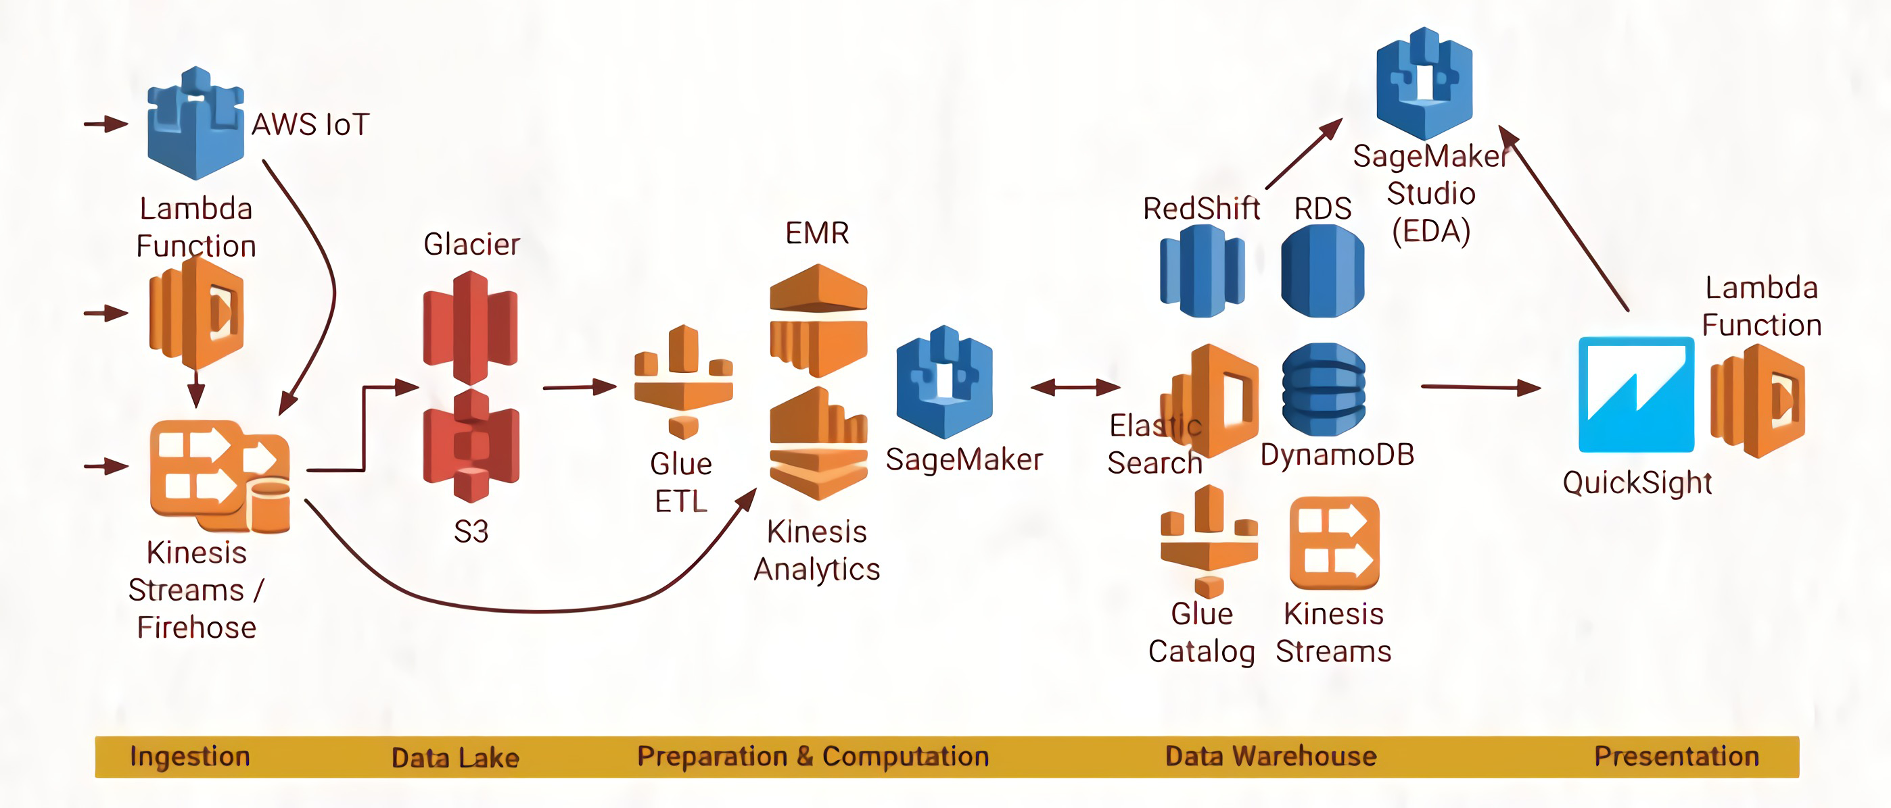
List of AWS services used, higher abstraction model

Slide 6
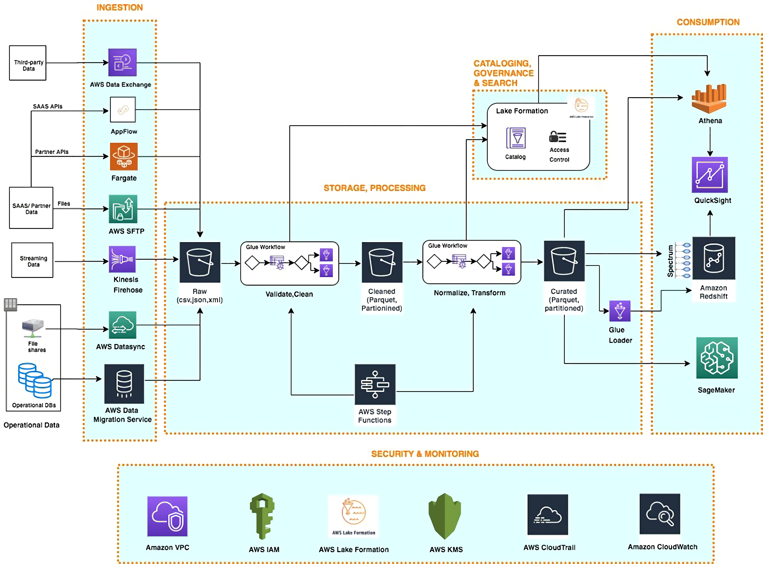

Slide 7
Reason why your solution should be considered for the final round

Slide 8
Source code (Submit your Code in Python only)

Slide 9
Demonstration Video showing the functionalities/working of the solution.

Slide 10

Submitted By: Md Zeeshan Alam
Email: gerialworld@gmail.com
Mobile No: +918448525602

